Slide 1



Object-Oriented Programming
Classes, Functional Constructors, Prototypes, Inheritance, Using "this" Object, Accessing Base Members
SoftUni Team
Technical Trainers
Software University
http://softuni.bg

Slide 2
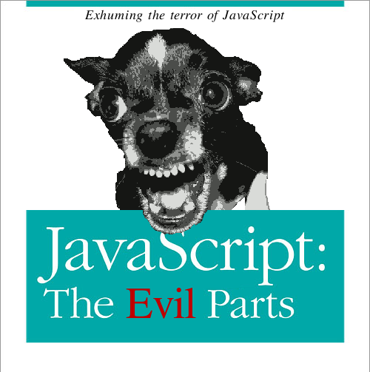
Table of Contents
Object-Oriented Programming in JavaScript
Classical OOP in JavaScript
Prototypes
Object Properties
Function Constructors
Inheritance in Classical OOP
The value of the this object
Prototypal OOP and Inheritance
OOP Frameworks

Slide 3
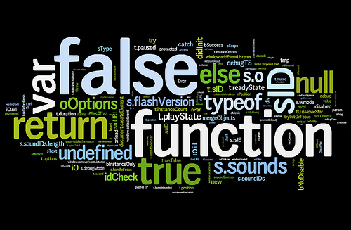
Object-Oriented Programming
And How It Works in JavaScript

Slide 4
Object-Oriented Programming
OOP means that the application is constructed as a set of objects
Each object has its purpose
Each object can hold other objects
JavaScript is prototype-oriented language
Uses prototypes to define its properties
Does not have definition for class or constructor
ECMAScript 6 will introduce classes

Slide 5
OOP in JavaScript
JavaScript is dynamic language
No such things as polymorphism
JavaScript is also highly expressive language
Most things can be achieved in many ways
That is why JavaScript has many ways to support OOP
Classical (Functional), Prototypal
Each has its advantages and drawbacks
Usage depends on the case

Slide 6
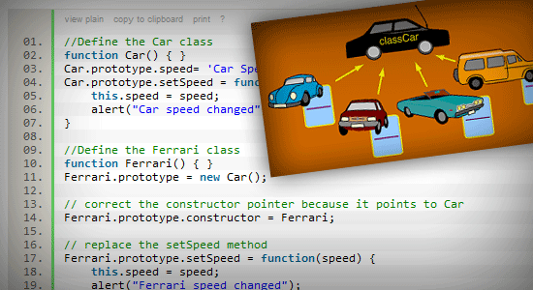
Classical OOP in JavaScript

Slide 7
Classical OOP
JavaScript uses functions to create objects
It has no definition for class or constructor
Functions play the role of object constructors
Create/initiate objects is done by calling the function with the "new" keyword
There is no need to explicitly define a constructor method
function Person() {}
var gosho = new Person(); // instance of Person

Slide 8
Creating Objects
When using a function as an object constructor it is executed when called with new
Each of the instances is independent
They have their own state and behavior
function Person() {}
var gosho = new Person(); // instance of Person
var maria = new Person(); // another instance of Person
gosho.name = "George";
maria.name = "Maria";
console.log(gosho.name); // George
console.log(maria.name); // Maria

Slide 9
Function Constructor with parameters
Function constructors can take parameters to give different state to instances
Just a regular function with parameters, invoked with new
function Person(name, age){
console.log("Name: " + name + ", Age: " + age);
}
var gosho = new Person("Georgi", 23);
// Name: Georgi, Age: 23
var maria = new Person("Maria", 18);
// Name: Maria, Age: 18

Slide 10

Function Constructors
Live Demo

Slide 11

Prototypes
The Prototype Object in JS

Slide 12
The Prototype Object
JavaScript is prototype-oriented programming language
Every object has a hidden property prototype (parent object)
E.g. String.prototype holds the String instances functions
Prototypes give properties to all instances
The Object type is the parent of all objects
Every object inherits Object and has toString() method
constructor
Specifies the function that creates an object's prototype

Slide 13
The Prototype Object
When adding properties to a prototype, all instances will get them
String.prototype.repeat = function (count) {
var str, i;
str = '';
for (i = 0; i < count; i += 1) {
str += this;
}
return str;
};
var s = "hi".repeat(2); // "hihi"
Add repeat(count) method to all string objects
Here this means the string itself

Slide 14
Prototypes
Demo
Live Demo

Slide 15
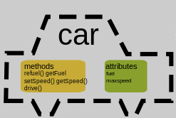
Object Members
Attaching Properties and Methods

Slide 16
Object Members – Properties
Objects can also define custom state
Custom properties that only instances of this type have
Use the keyword this to attach properties to object
function Person(name, age) {
this._name = name;
this._age = age;
}
var maria = new Person("Mariika", 18);
console.log(maria._name); // Mariika
maria._name = "Peter";
console.log(maria._name); // Peter

Slide 17
Object Members - Methods
Property values can be either variables or functions
Functions attached to object are called methods
function Person(name, age) {
this._name = name;
this._age = age;
this.sayHello = function() {
console.log("My name is " + this._name +
" and I'm " + this._age + "-years old");
}
}
var maria = new Person("Maria", 18);
maria.sayHello(); // My name is Maria and I'm 18-years old

Slide 18
Object Members
Live Demo

Slide 19
Attaching Methods
Attaching methods in the object constructor is a tricky operation
Its is slow (repeated at each object creation)
Every object has a different (duplicated) function instance
function Person(name, age) {
this.introduce = function() {
return 'Name: ' + name + ', Age: ' + age;
};
}
var p1 = new Person();
var p2 = new Person();
console.log(p1.introduce === p2.introduce); // false

Slide 20


Better Method Attachment
Instead of attaching the methods to this in the constructor
Attach them to the prototype of the constructor
Methods attached to constructor's prototype are created exactly once
function Person(name, age) {
this.sayHello = function() {
// ...
}
}
function Person(name, age) { }
Person.prototype.sayHello = function() {
// ...
}

Slide 21


Attaching Methods to the Prototype
Live Demo

Slide 22


Pros and Cons when Attaching Methods
Attaching to prototype
Using JavaScript as it is meant
No hidden data
A way better performance
Attaching to this
Code closer to other languages
Hidden data
Not good performance
JavaScript is NO other language!
Hidden data is not a big problem. Prefix "hidden" data with _
Performance is a big deal!
It should be taken into serious consideration

Slide 23
The this Object

Slide 24
The this Object
this is a special kind of object
It is available everywhere in JavaScript
It has different meaning in different contexts
The this object can have two different values:
The parent scope
The value of this of the containing scope
If none of the parents is object, its value is window / global object
A concrete object
When using the new operator

Slide 25
this in Function Scope
When executed over a function, without the new operator
this refers to the parent scope
function Person(name) {
this._name = name;
this.getName = function getPersonName() {
return this._name;
}
}
var p = new Person("Gosho");
var getName = p.getName;
console.log(p.getName()); // Gosho
console.log(getName()); // undefined
Here this means the Person object
Here this means its parent scope (window)

Slide 26
The this Function Object
Live Demo

Slide 27
Function Constructors
this doesn't make a closure
The only way to make closure is to cache this in another variable
Then we can call functions without context
Doesn't work for methods attached to the prototype
Creating closure (holding this)
function Person(name) {
var self = this;
self._name = name;
self.getName = function getPersonName() {
return self._name;
}
}
var p = new Person("Peter");
var getPersonName = p.getName;
console.log(getPersonName()); // Logs: Peter

Slide 28
Function Constructors
JavaScript cannot limit function to be used only as constructors
JavaScript was designed for simple UI purposes
To mark something as contructor, name it in PascalCase
Convention: PascalCase-named functions should be called with new
function Person(name) {
this._name = name;
this.getName = function getPersonName() {
return this._name;
}
}
var p = Person("Peter");
What will be the value of this?

Slide 29

Invoking Function Constructors Without new
Live Demo

Slide 30
Function Constructor Fix
John Resig (jQuery) designed a simple way to check if the function is not used as constructor:
function Person(name, age) {
if (!(this instanceof arguments.callee)) {
return new arguments.callee(name, age);
}
this._name = name;
this._age = age;
}
If this is not of type the function, call the function with new

Slide 31
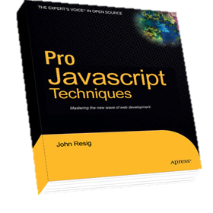
John Resig Constructor Fix
Live Demo

Slide 32
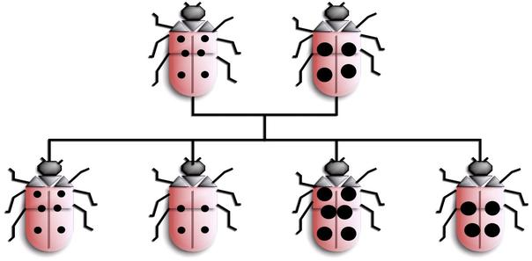
Inheritance in Classical OOP
Like in C#, Java or C++

Slide 33
Inheritance in Classical OOP
Inheritance is a way to extend the functionality of an object
Like Student inherits Person
In JavaScript inheritance is achieved by setting the prototype of the derived type to an instance of the super type
Now Student objects are also of type Person
function Person(fname, lname) {}
function Student(fname, lname, grade) {}
Student.prototype = new Person();
var student = new Student("Kiro", "Troikata", 7);

Slide 34
How to Inherit the prototype Object?
Student.prototype = Person.prototype;
Didn't work! Both refer to same object
Adding something to Child.prototype, will be added to Parent.prototype
Student.prototype = new Person();
This invokes the constructor which might have undesired side effects
Student.prototype = Object.create(Person.prototype);
Object.prototype.extends = function (parent) {
this.prototype = Object.create(parent.prototype);
this.prototype.constructor = this;
}

Slide 35
Fixing Missing Object.create(…)
Modern browsers already have Object.create(…)
Easy to be fixed for all browsers:
Object.prototype.extends = function (parent) {
if (!Object.create) {
Object.prototype.create = function (proto) {
function F() {};
F.prototype = proto;
return new F();
};
};
this.prototype = Object.create(parent.prototype);
this.prototype.constructor = this;
}

Slide 36
Inheritance in Classical OOP
Live Demo

Slide 37

The Prototype Chain
The Way to Search Properties in JavaScript

Slide 38
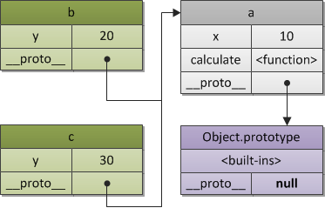
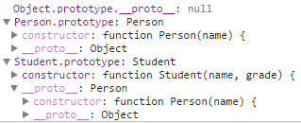
The Prototype Chain
Objects in JavaScript can have only a single prototype
Their prototype also has a prototype, etc…
This is called the prototype chain
When a property is called on an object
This object is searched for the property
If the object does not contain such property, its prototype is checked for the property, etc…
If a null prototype is reached, the result is undefined

Slide 39
Prototype Chain
undefined
Object.prototype
Person.prototype
key | value
constructor | Object
toString | function() { … }
valueOf | function() { … }
hasOwnProperty | function() { … }
isPrototypeOf | function() { … }
__proto__ | null
key | value
constructor | Person
toString | firstName + lastName
firstName
lastName
__proto__ | Object.prototype
Student.prototype
function Person(fname, lname) { … }
function Student(grade) { … }
Student.extends(Person);
var st = new Student(
"Peter", "Petrov", 4);
st.sayHello();
key | value
constructor | Student
toString | firstName + lastName + grade
grade
__proto__ | Person.prototype

Slide 40
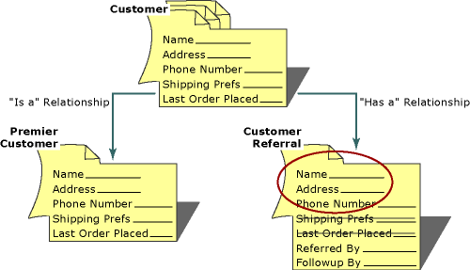
Calling Parent Methods
Reusing Logic from the Inherited Class

Slide 41
Calling Parent Methods
JavaScript has no direct way of calling its parent methods
Function constructors actually does not who or what is their parent
Calling parent methods is done using call(…) and apply(…)

Slide 42
Calling Parent Methods: Example
Define a Shape class
var Shape = (function () {
function Shape(x, y) {
// Initialize the shape
}
Shape.prototype = {
serialize: function () {
// Serialize the shape // Return the serialized
}
};
return Shape;
}());

Slide 43
Calling Parent Methods: Example (2)
var Rect = (function () {
function Rect(x, y, width, height) {
Shape.call(this, x, y);
this.witdh = width;
this.height = height;
}
Rect.prototype = Object.create(Shape.prototype);
Rect.prototype.serialize = function (){
Shape.prototype.serialize.call(this);
// add Rect-specific serialization
// and return the serialized rectangle
};
return Rect;
}());
Calling the parent constructor
Rect inherits Shape
Calling the parent serialize() function

Slide 44
Calling Parent Methods
Live Demo

Slide 45

Function Constructors with Modules

Slide 46
Constructors with Modules
Function constructors can be put inside a module
Introduces a better abstraction of the code
Allows to hide constants and functions
var Person = (function () {
var MAX_NAME_LENGTH = 50; // private const
function Person(name) { // constructor
this._name = name;
}
Person.prototype.walk = // public method
function (distance) { … };
function calcDistance(…) { // private
… // function hidden in the module
}
return Person;
}());

Slide 47
Function Constructors with Modules
Live Demo

Slide 48

Hidden Functions
What to Do When We Want to Hide Something?

Slide 49
Hidden Functions
When a function constructor is wrapped inside a module:
The module can hold hidden functions
The function constructor can use these hidden functions
Yet, to use these functions as object methods, we should use apply(…) or call(…)
In order to pass correct this

Slide 50
Hidden Functions: Example
var Rect = (function () {
function validatePosition() {
// …
}
function Rect(x, y, width, height) {
var isPositionValid = validatePosition.call(this);
if (!isPositionValid) {
throw new Error('Invalid Rect position');
}
}
Rect.prototype = { /* … */ };
return Rect;
}());
This function is not exposed from the module
Using call() to invoke the function over this

Slide 51
Hidden Functions
Live Demo

Slide 52
Methods Attached to the Function Constructor
var Rect = (function () {
function Rect(width, height) {
this.width = width;
this.height = height;
}
Rect.prototype.calculateArea = function () { };
Rect.isSquare = function(rect) {
return rect.width === rect.height;
}
return Rect;
}());
Works as a static method. Invoked through the class, not through the instances.
Should not access this.

Slide 53

Prototypal OOP
Another Way to Work with Classes in JS

Slide 54
Prototypal OOP
Prototypal OOP uses the prototype nature of JS to produce objects
Objects are created from objects, instead from functions
Simple approach: all properties / methods are public
var Person = {
init: function(name) {
this._name = name;
return this;
},
introduce: function introduce() {
return "Hello my name is: " + this._name;
}
}
var pesho = Object.create(Person).init('Peter');
console.log(pesho.introduce()); // Name: Peter, Age: 69
The init() function works as a constructor
Creating an object from Person

Slide 55
Prototypal Inheritance
Prototypal inheritance is not like the classical inheritance
All instances are created from a common JS object, i.e. instanceof does not work
The inheritance is much like the Object.create(), but adds more properties
Extend the Person object and add Student specific functionality
Object.prototype.extend = function(properties) {
function f() {};
f.prototype = Object.create(this);
for (var prop in properties) {
f.prototype[prop] = properties[prop];
}
f.prototype._super = this;
return new f();
}
Set the prototype to this of the extended object
Add the derived object properties
Keep a reference to the super object
var Person = {…}
var Student = Person.extend({…});

Slide 56
Prototypal Inheritance (2)
var Person = {
init: function init(name, age) {
this.name = name;
this.age = age;
return this;
},
introduce: function introduce() {
return this.name + " " + this.age;
}
};
var Student = Person.extend({
init: function init(name, age, grade) {
this._super.init.call(this, name, age);
this.grade = grade;
return this;
}
})
Call Person's init() method

Slide 57
Prototypal OOP
Live Demo

Slide 58

OOP Frameworks for JavaScript

Slide 59
JS OOP Frameworks
OOP is a primary design paradigm in most programming languages
Yet, OOP in JavaScript is not that perfect
CofeeScript and TypeScript have better OOP
And that is why every framework has its own way of doing OOP
YUI, Prototype.js, Backbone.js, etc…
If none of these frameworks is used, a simple implementation by John Resig is intruded

Slide 60
John Resig's Simple Inheritance
http://ejohn.org/blog/simple-javascript-inheritance/
var Shape = Class.extend({
init: function(x, y) {
this._x = x;
this._y = y;
},
serialize: function() {
return {
x: this._x,
y: this._y
};
}
});
Create a class
init() function is required

Slide 61
John Resig Simple Inheritance
Inherit Shape
var Rect = Shape.extend({
init: function(x, y, w, h) {
this._super(x, y);
this._width = w;
this._height = h;
},
serialize: function() {
var res = this._super();
res.width = this._width;
res.height = this._height;
return res;
}
});
Calling the parent constructor
Calling the parent serialize()

Slide 62

John Resig's Simple Inheritance
Live Demo

Slide 63







JavaScript Object-Oriented Programming
https://softuni.bg/courses/javascript-oop/

Slide 64
License
This course (slides, examples, demos, videos, homework, etc.) is licensed under the "Creative Commons Attribution-NonCommercial-ShareAlike 4.0 International" license
Attribution: this work may contain portions from
“JavaScript OOP" course by Telerik Academy under CC-BY-NC-SA license

Slide 65





Free Trainings @ Software University
Software University Foundation – softuni.org
Software University – High-Quality Education, Profession and Job for Software Developers
softuni.bg
Software University @ Facebook
facebook.com/SoftwareUniversity
Software University @ YouTube
youtube.com/SoftwareUniversity
Software University Forums – forum.softuni.bg

